Slide 1
Tutorial 5
Statistical Computation and Analysis
Spring 2026

Slide 2
Tutorial Outline
The null model
Effect sizes
Bayesian hypothesis testing
ROPE and HDI test
Type I and II errors
Significance
Power
Frequentist hypothesis testing
Z test

Slide 3
From estimation to hypothesis testing
Until now we talked about data, modeling & estimation.
Today we’ll discuss the null model and hypothesis testing as a way to decide whether data contradict, support, or fail to resolve a null model.

Slide 4

The Null Model
Null model - a default or naive model, often assuming no effect, no difference, no relationship, or no influence.
Null hypothesis - the hypothesis that the null model is true.
Referred to as $H_{0}$

Slide 5
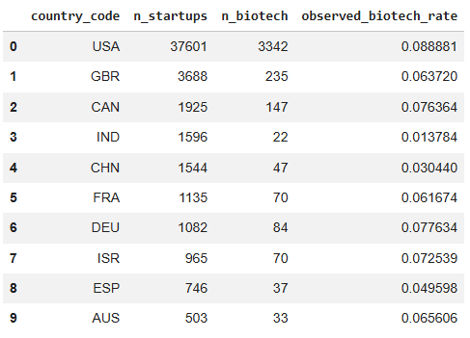
Dataset

Slide 6
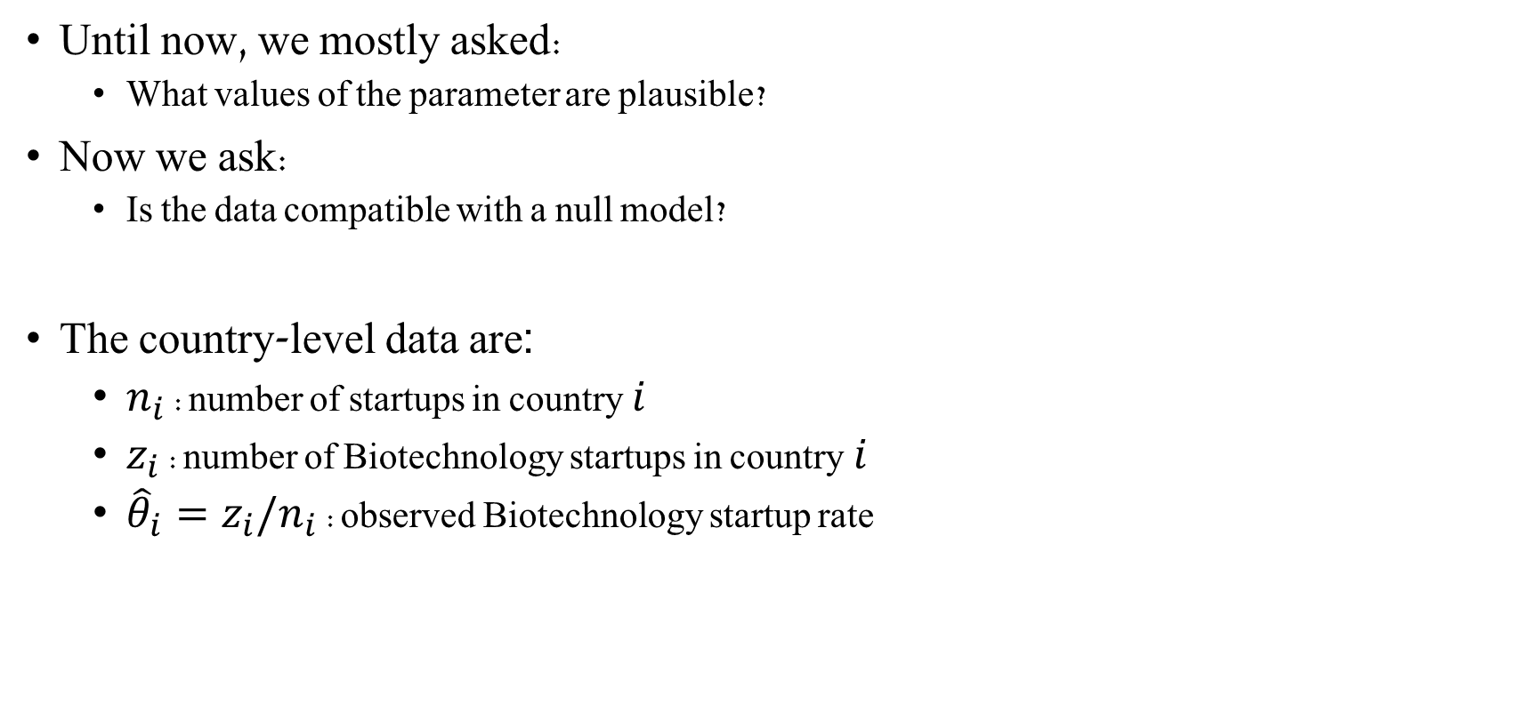
Dataset - The Null Model
Until now, we mostly asked:
What values of the parameter are plausible?
Now we ask:
Is the data compatible with a null model?
The country-level data are:
$n_{i}$: number of startups in country $i$
$z_{i}$: number of Biotechnology startups in country $i$
${\hat{θ}}_{i}=z_{i}/n_{i}$: observed Biotechnology startup rate

Slide 7
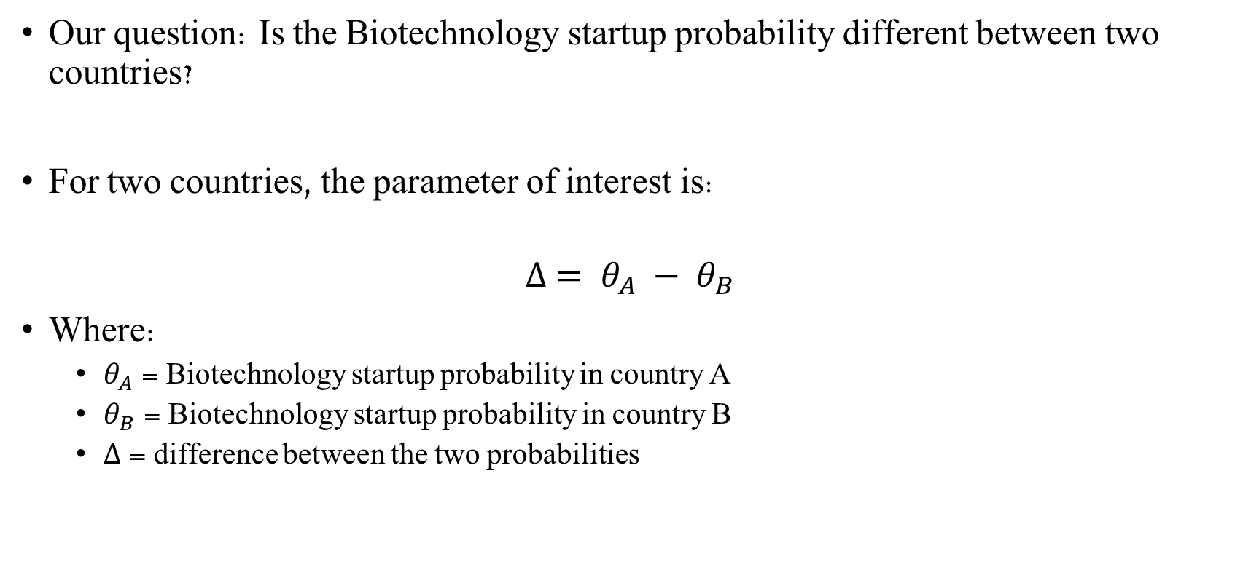
Dataset - The Null Model
Our question: Is the Biotechnology startup probability different between two countries?
For two countries, the parameter of interest is:
$$∆ = θ_{A} − θ_{B}$$
Where:
$θ_{A}$ = Biotechnology startup probability in country A
$θ_{B}$= Biotechnology startup probability in country B
$∆$= difference between the two probabilities

Slide 8
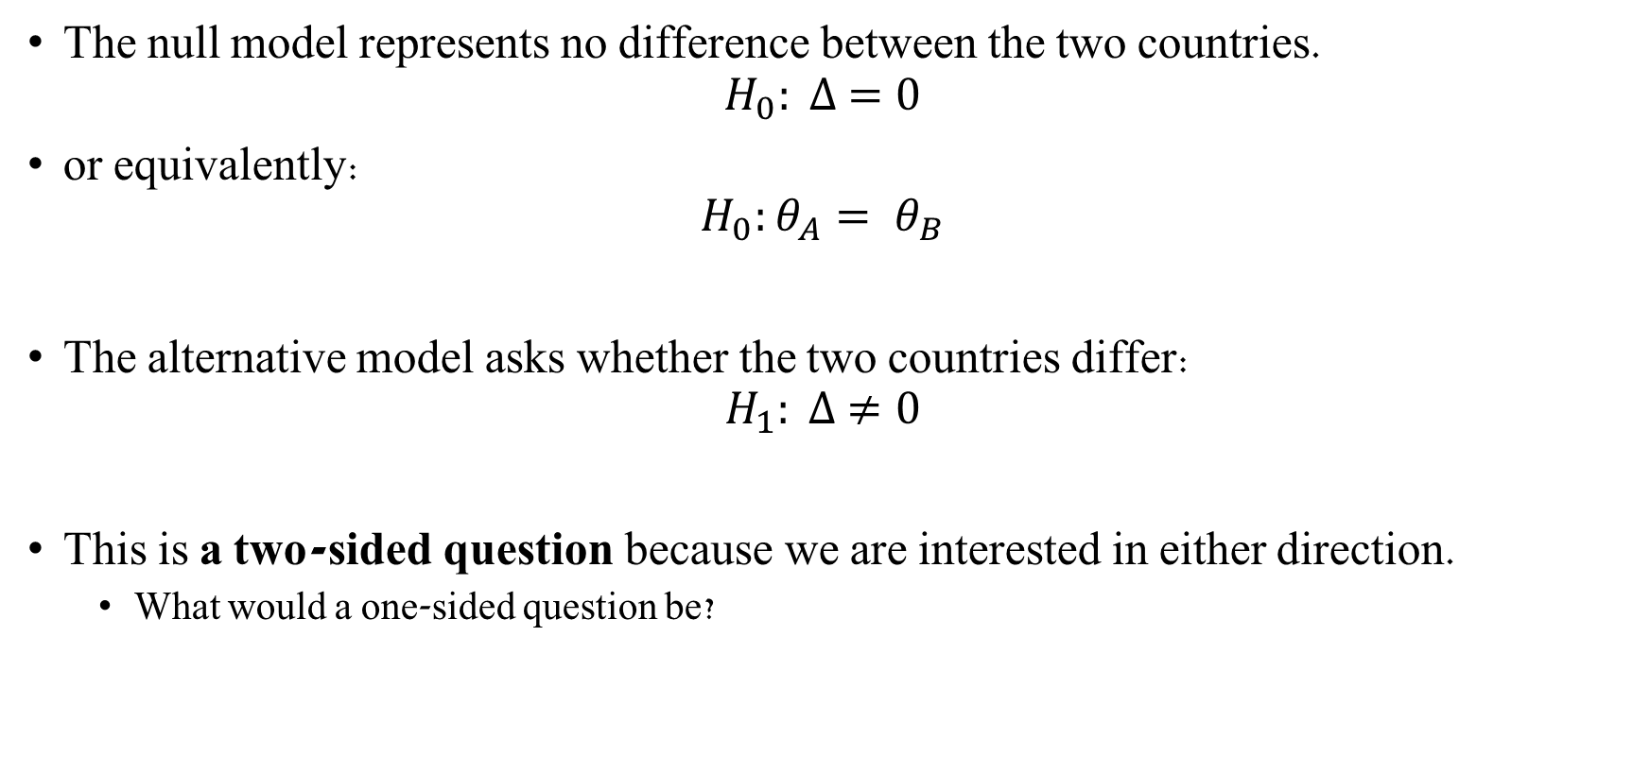
Dataset - The Null Model
The null model represents no difference between the two countries.
$$H_{0}: ∆ =0$$
or equivalently:
$$H_{0}:θ_{A}= θ_{B}$$
The alternative model asks whether the two countries differ:
$$H_{1}: ∆ ≠0$$
This is a two-sided question because we are interested in either direction.
What would a one-sided question be?

Slide 9
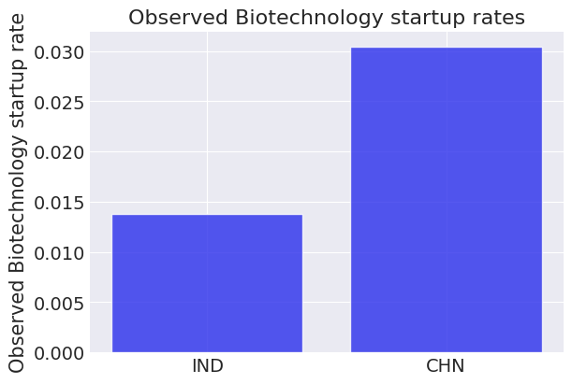
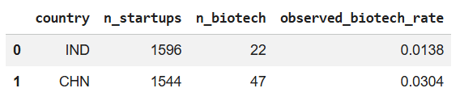
Dataset - The Null Model
Let’s choose 2 countries and describe the data
country_A = "IND"
country_B = "CHN"
Notes:
$$H_{0}: ∆ =0$$
$$H_{1}: ∆ ≠0$$

Slide 10
Effect Size - Terms
Effect size - the difference between reality and the null hypothesis
True effect size - the effect size in reality
Measured effect size - the effect size estimated from data
Normalized effect size - an effect-size statistic designed to be comparable across experiments and domains
Notes:
Effect size answers:
How large is the observed difference?
Hypothesis testing answers:
Are the data difficult to explain under the null model?
Raw effect size
Depends on domain knowledge
Useful for comparing similar experiments
Meaningful in application and impact
Carries greater weight for experts
Normalized effect size
Convenient for non-experts
Useful for comparing across fields
Helpful as a rule of thumb

Slide 11
Effect Size - Terms
Raw effect size - an effect size expressed in the actual units of the data
Useful for comparing similar experiments
Depends on domain knowledge
Meaningful in application and impact
Carries greater weight for experts
Normalized effect size - an effect-size statistic designed to be comparable across experiments and domains.
Convenient for non-experts
Useful for comparing across fields
Helpful as a rule of thumb
Notes:
Effect size answers:
How large is the observed difference?
Hypothesis testing answers:
Is the data difficult to explain under the null model?

Slide 12

Effect Size - Terms
Cohen’s h - a normalized effect size for comparing proportions or probabilities.
$${Cohen}^{′}s h= 2\arcsin{\sqrt{θ}}−2\arcsin{\sqrt{θ_{0}}}$$
|Cohen’s h| | Effect size
0.2 | Small
0.5 | Medium
0.8 | Large
Notes:
Effect size answers:
How large is the observed difference?
Hypothesis testing answers:
Are the data difficult to explain under the null model?

Slide 13
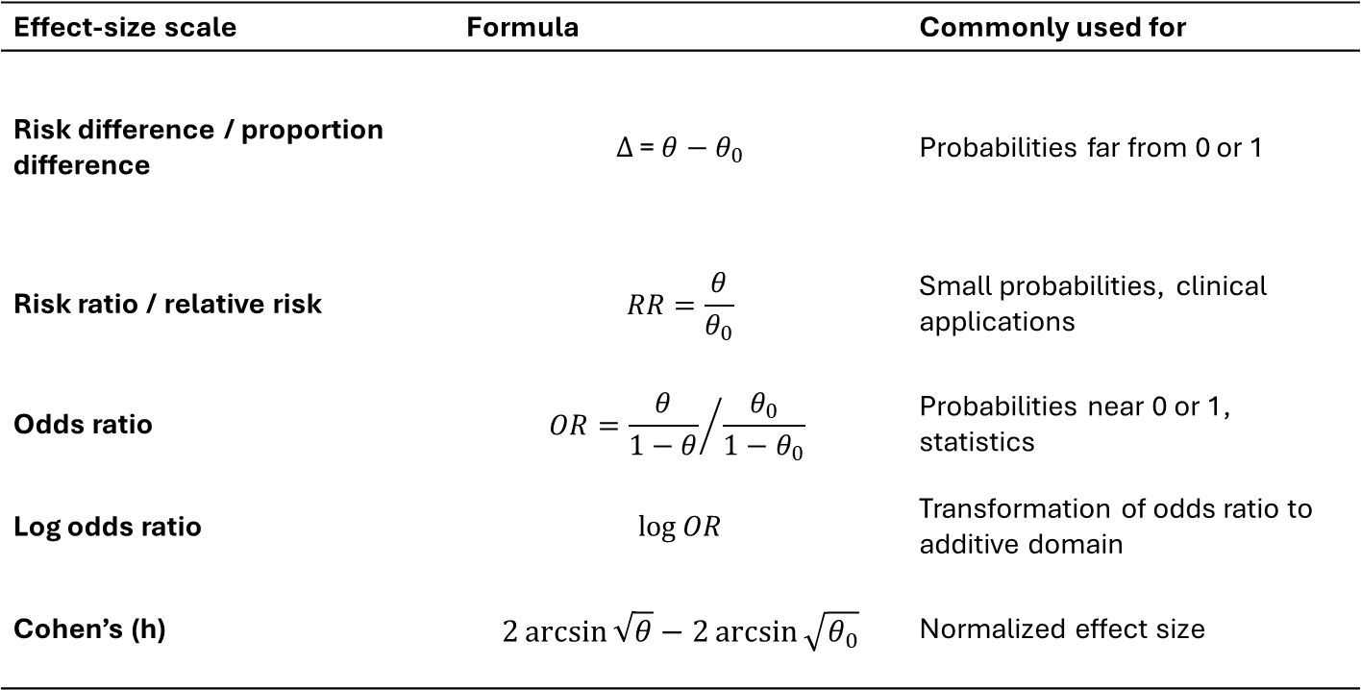
Effect Size Measures
Effect-size scale | Formula | Commonly used for
Risk difference / proportion difference | $$Δ\text{ = }θ−θ_{0}$$ | Probabilities far from 0 or 1
Risk ratio / relative risk | $$RR=\frac{θ}{θ_{0}}$$ | Small probabilities, clinical applications
Odds ratio | $$OR={\frac{θ}{1−θ}}/{\frac{θ_{0}}{1−θ_{0}}}$$ | Probabilities near 0 or 1, statistics
Log odds ratio | $$\log{OR}$$ | Transformation of odds ratio to additive domain
Cohen’s (h) | $$2\arcsin{\sqrt{θ}}−2\arcsin{\sqrt{θ_{0}}}$$ | Normalized effect size
Notes:
Effect size answers:
How large is the observed difference?

Slide 14
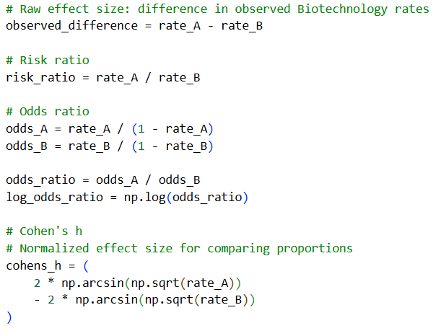
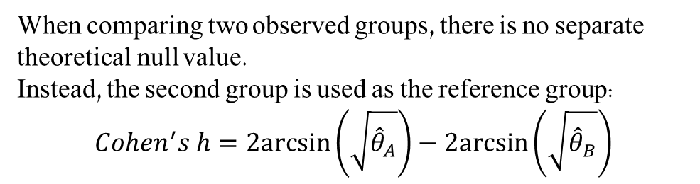
Data - Measured effect sizes
When comparing two observed groups, there is no separate theoretical null value. Instead, the second group is used as the reference group:
$$Cohen^{′}s h=2arcsin⁡\left(\sqrt{{\hat{θ}}_{A}}\right)−2arcsin⁡\left(\sqrt{{\hat{θ}}_{B}}\right)$$

Slide 15
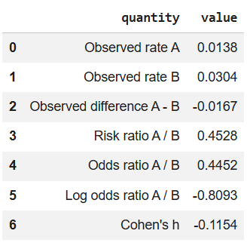
Data - Measured effect sizes

Slide 16
Data - Measured effect sizes
Effect size answers:
How large is the observed difference?
Hypothesis testing answers:
Is the data difficult to explain under the null model?
A small effect can become statistically significant with a very large sample.
A large observed effect can remain uncertain with a small sample.

Slide 17

Bayesian Hypothesis Testing
We calculated the observed difference
let’s see what does the model say about the difference after accounting for uncertainty.
We do not only compare one observed number to a null value. Instead, we examine the posterior distribution of the effect:
$$Δ=θ_{A}−θ_{B}$$
This allows us to ask:
Is most of the posterior above or below 0?
Does the HDI include the null value?
Is the difference practically meaningful?
Notes:
To answer these questions, we first need a Bayesian model that estimates $θ_{A}$, $θ_{B}$, and their difference $Δ$.

Slide 18
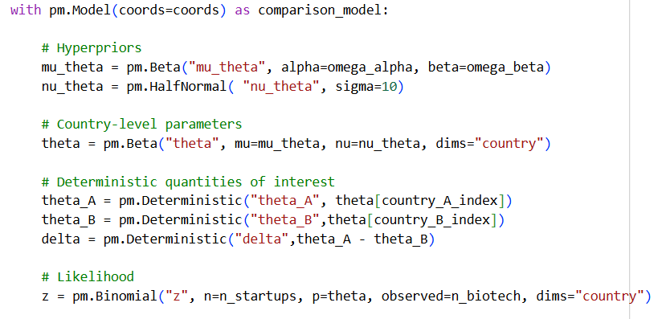
Bayesian modeling

Slide 19
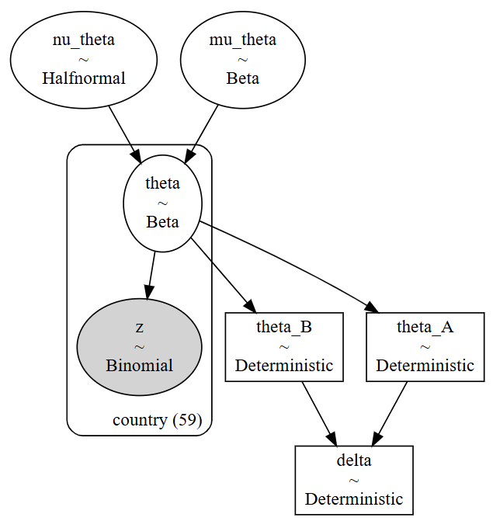
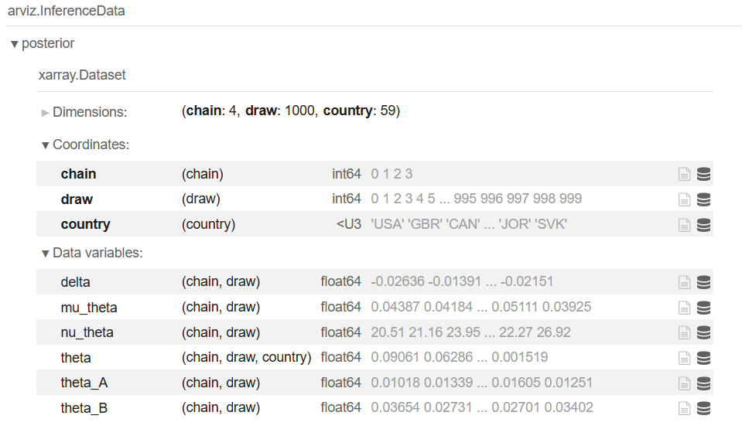
Idata with pm.Deterministic
Notes:
This gives a full posterior distribution for the difference.
That posterior can then be used for:
posterior mean and median
HDI
ROPE/HDI test
Savage-Dickey / Bayes factor

Slide 20
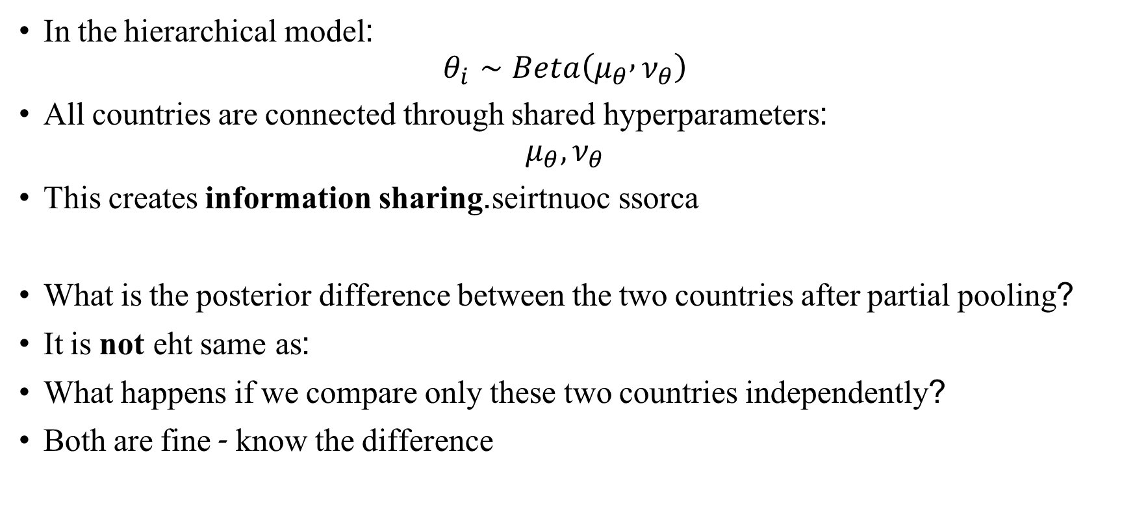
What comparison are we making?
In the hierarchical model:
$$θ_{i}∼Beta\left(μ_{θ} , ν_{θ}\right)$$
All countries are connected through shared hyperparameters:
$$μ_{θ},ν_{θ}$$
This creates information sharing across countries.
What is the posterior difference between the two countries after partial pooling?
It is not the same as:
What happens if we compare only these two countries independently?
Both are fine - know the difference

Slide 21
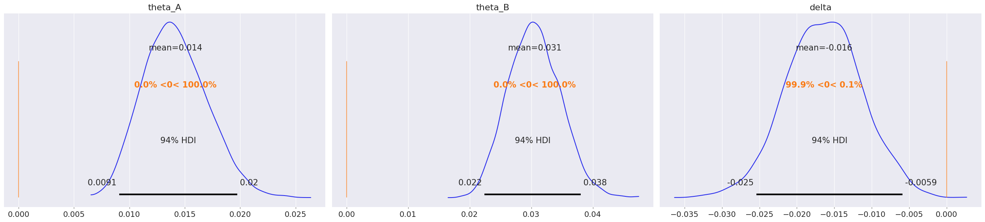
Bayesian modeling
Posterior results
Notes:
country_A = "IND"
country_B = "CHN"

Slide 22
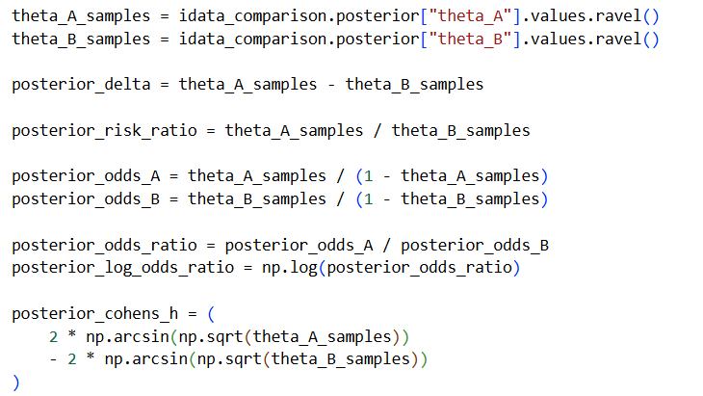
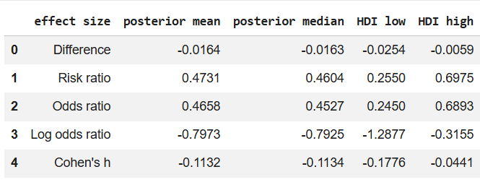
Model - Effect size
We can also calculate the different effect sizes:
|Cohen’s h| | Effect size
0.2 | Small
0.5 | Medium
0.8 | Large

Slide 23

Bayesian Posterior Comparison
Interpret the posterior distribution of:
$$Δ=θ_{A}−θ_{B}$$
Should calculate and interpret:
Posterior mean of $Δ$
Posterior median of $Δ$
94% HDI
$P\left(Δ>0∣data\right)$
$P\left(Δ<0∣data\right)$
Notes:
This is a direct Bayesian statement about the parameter.
For example:
$$P\left(Δ>0∣data\right)=0.92$$
means:
Under this model, given the data, 92% of posterior draws suggest that country A has a higher Biotechnology startup probability than country B.
This is not a p-value!

Slide 24
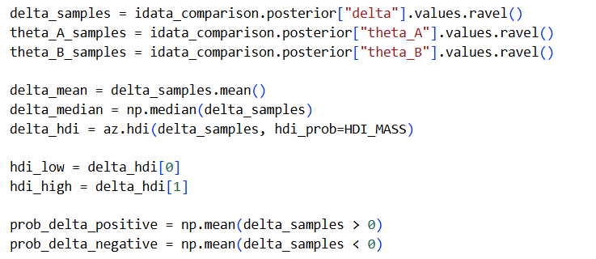

Bayesian Posterior Comparison
After fitting the model, interpret the posterior distribution of:
$$Δ=θ_{A}−θ_{B}$$
Should calculate and interpret:
Posterior mean of $Δ$
Posterior median of $Δ$
94% HDI
$P\left(Δ>0∣data\right)$
$P\left(Δ<0∣data\right)$
Notes:
This is a direct Bayesian statement about the parameter.
For example:
$$P\left(Δ>0∣data\right)=0.001$$
means:
Under this model, given the data, 0.1% of posterior draws suggest that country A has a higher Biotechnology startup probability than country B.
This is not a p-value.
The code .values.ravel() is a common pattern used in Python (specifically with the Pandas and NumPy libraries) to convert a high-dimensional data structure, like a DataFrame or Series, into a flat, 1D array

Slide 25
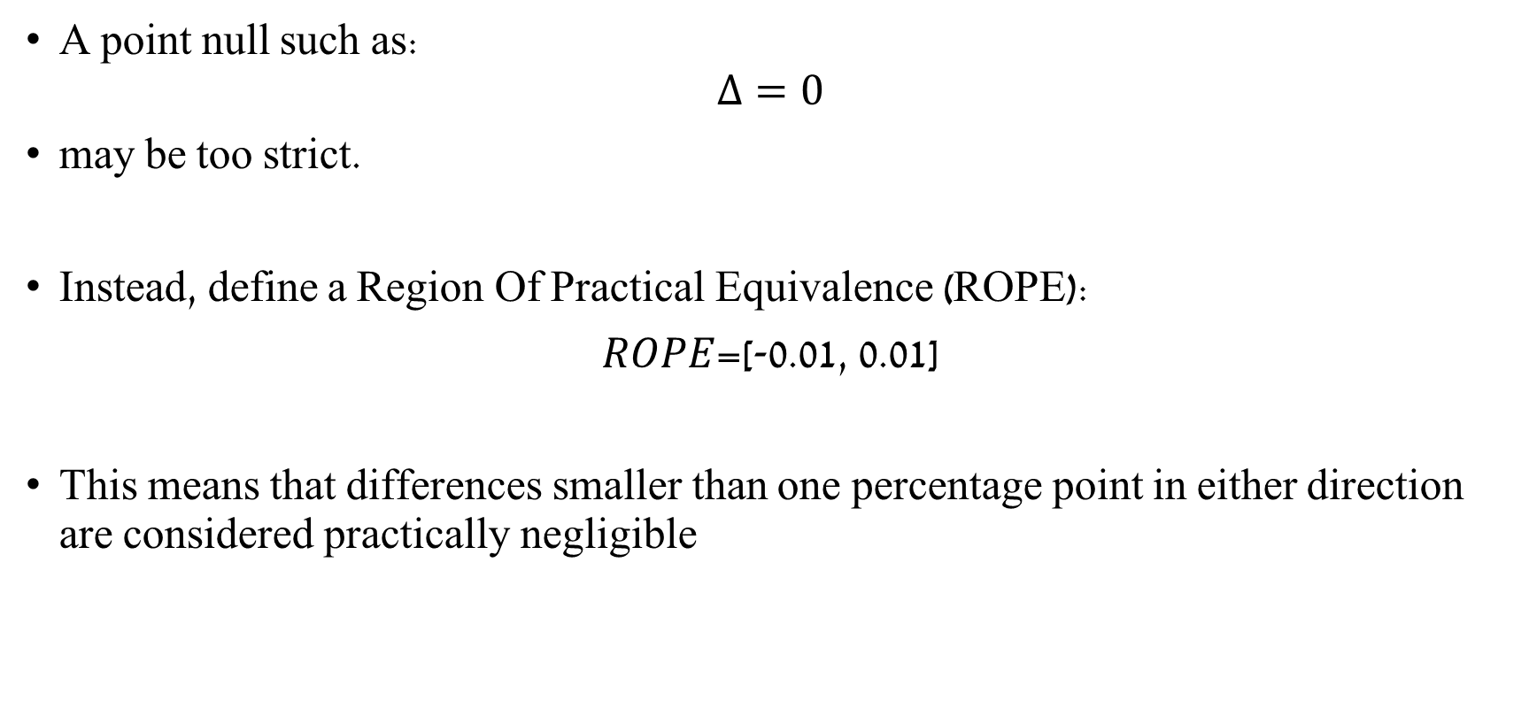
ROPE
A point null such as:
$$Δ=0$$
may be too strict.
Instead, define a Region Of Practical Equivalence (ROPE):
𝑅𝑂𝑃𝐸=[-0.01, 0.01]
This means that differences smaller than one percentage point in either direction are considered practically negligible
Notes:
The ROPE is not a mathematical default. It is a domain-based choice.
Decision logic
HDI completely outside ROPE → reject the practical null.
HDI completely inside ROPE → accept the practical null.
HDI partly overlaps ROPE → no clear decision.

Slide 26
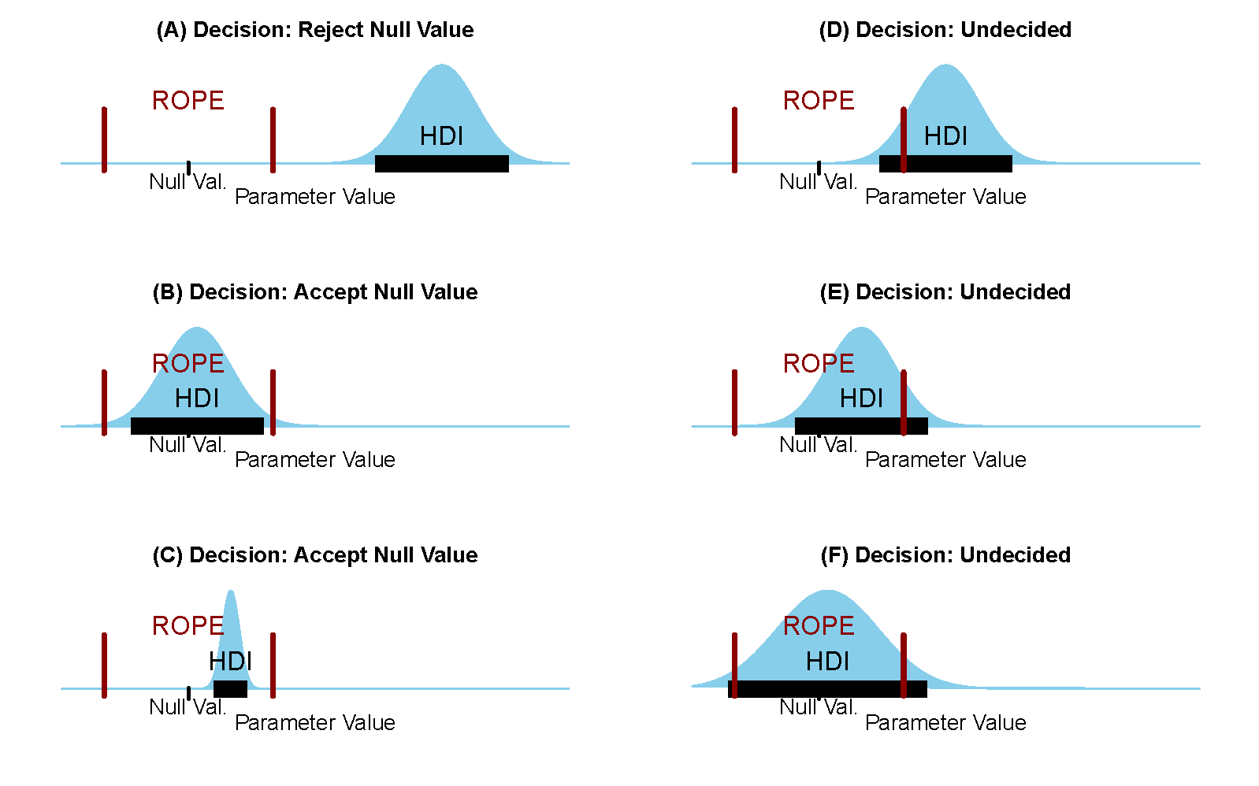
ROPE and HDI Test
The ROPE is not a mathematical default. It is a domain-based choice.
Decision logic:
HDI completely outside ROPE → reject the practical null.
HDI completely inside ROPE → accept the practical null.
HDI partly overlaps ROPE → no clear decision.

Slide 27
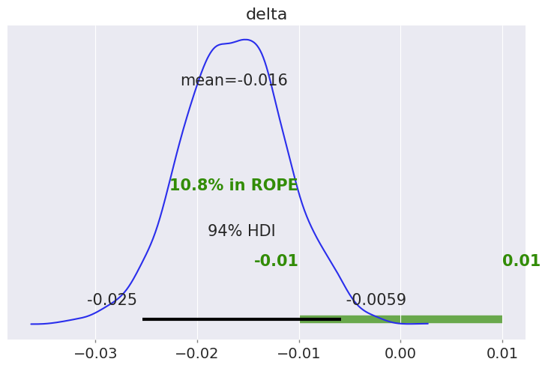
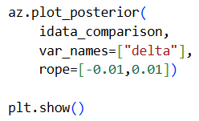
ROPE and HDI Test

Slide 28
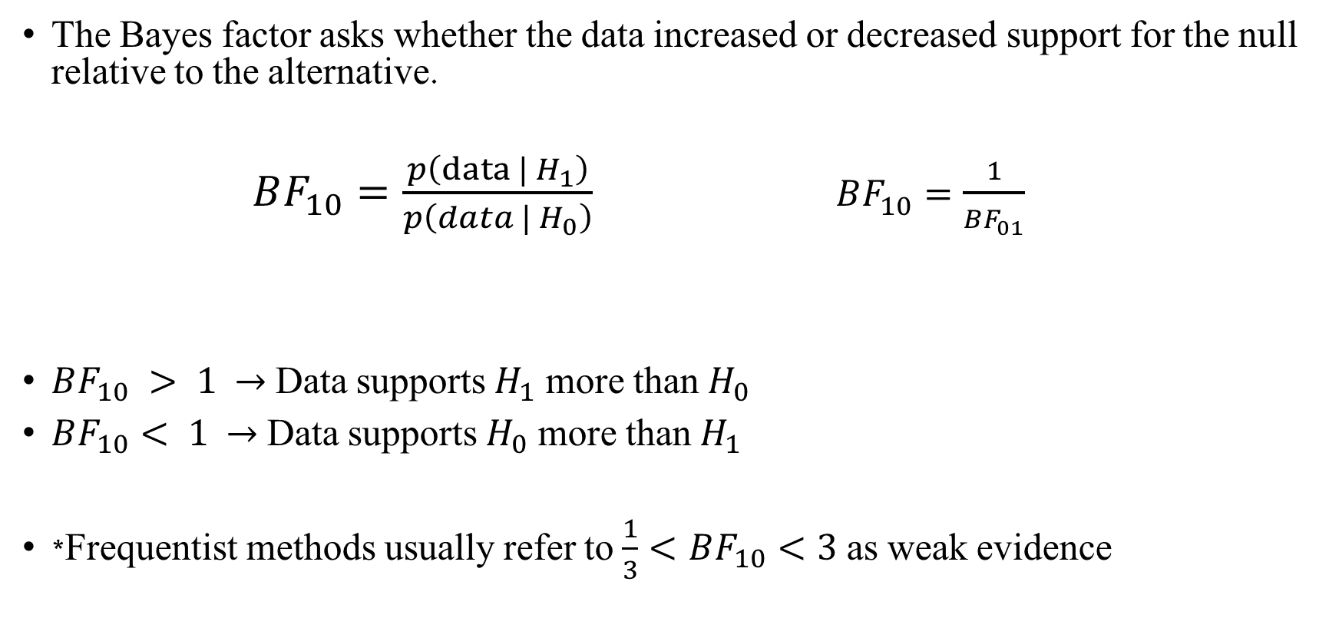


Bayes factor
The Bayes factor asks whether the data increased or decreased support for the null relative to the alternative.
$BF_{10}=\frac{p\left(data | H_{1}\right)}{p\left(data | H_{0}\right)} BF_{10}=\frac{1}{BF_{01}}$
$BF_{10} > 1$ $→$ Data supports $H_{1}$ more than $H_{0}$
$BF_{10}< 1$ $→$ Data supports $H_{0}$ more than $H_{1}$
*Frequentist methods usually refer to $\frac{1}{3}<BF_{10}<3$as weak evidence
$$H_{1}$$
$$H_{0}$$
Notes:
Bayes factor is sensitive to the prior.
It should not be interpreted alone.
It should be read together with the posterior plot, HDI, and ROPE decision.
This section should be shorter than the ROPE/HDI section.
Code reference
The code computes the density at zero using KDE and also uses az.plot_bf.

Slide 29
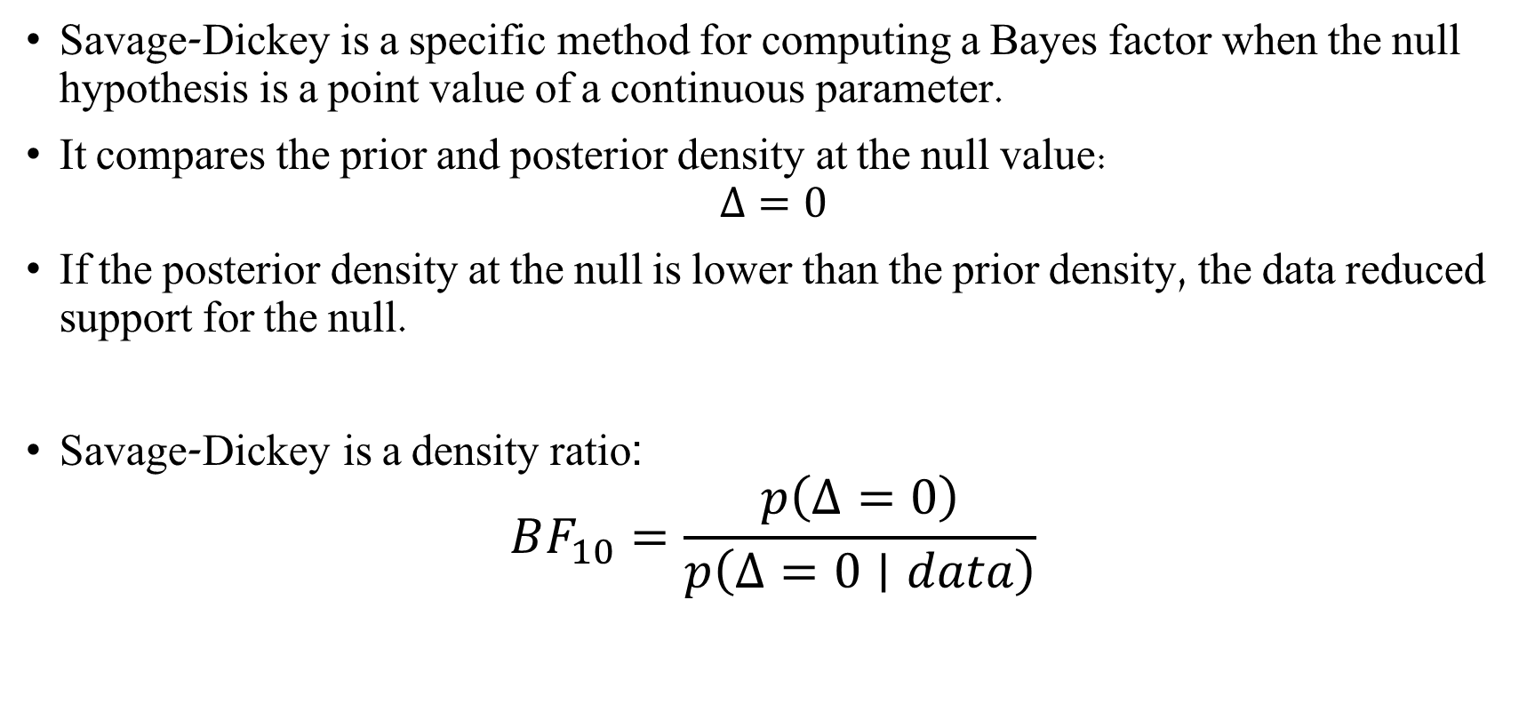
Savage-Dickey and Bayes factor
Savage-Dickey is a specific method for computing a Bayes factor when the null hypothesis is a point value of a continuous parameter.
It compares the prior and posterior density at the null value:
$$Δ=0$$
If the posterior density at the null is lower than the prior density, the data reduced support for the null.
Savage-Dickey is a density ratio:
$$BF_{10}=\frac{p\left(Δ=0\right)}{p\left(Δ=0∣data\right)}$$
Notes:
Savage-Dickey is a useful way to compute a Bayes factor for a point null, but it is sensitive to the prior and to numerical density estimation.
Therefore, it should be interpreted together with the posterior, HDI, and ROPE.

Slide 30

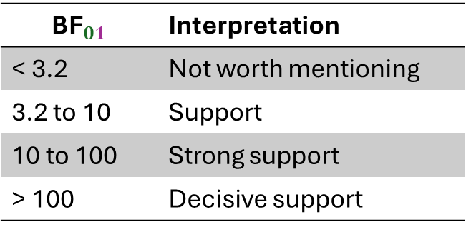
Savage-Dickey
$\text{Savage}\text{−}\text{Dickey} \text{is} \text{bidirectional}$
$\text{Show} \text{null} \text{hypothesis} \text{is} \text{contradicted} \text{by} \text{data}\text{: } {BF}_{01}>10$
$\text{Show} \text{null} \text{hypothesis} \text{is} \text{supported} \text{by} \text{data}\text{: }{BF}_{10}>10$
$\text{No} \text{strong} \text{evidence}\text{: }0.1<{BF}_{01}<10$
$${\text{BF}}_{01}$$ | Interpretation
< 3.2 | Not worth mentioning
3.2 to 10 | Support
10 to 100 | Strong support
> 100 | Decisive support
Notes:
Bayes factor is sensitive to the prior.
It should not be interpreted alone.
It should be read together with the posterior plot, HDI, and ROPE decision.
This section should be shorter than the ROPE/HDI section.
Code reference
The code computes the density at zero using KDE and also uses az.plot_bf.

Slide 31
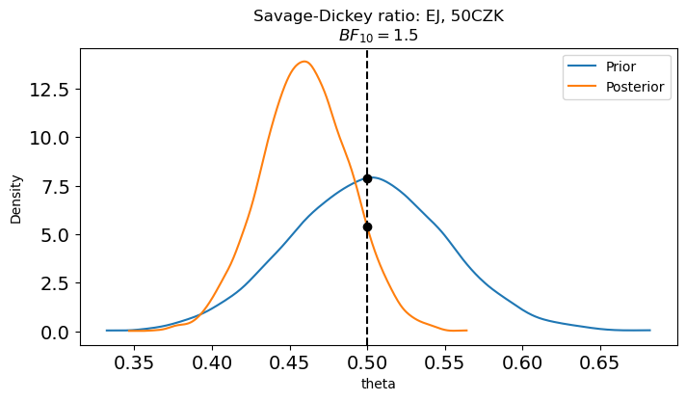
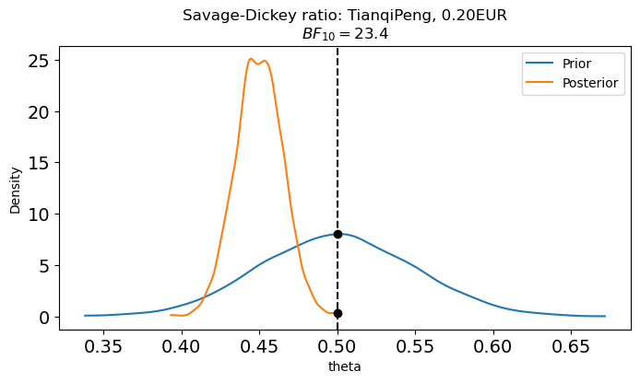
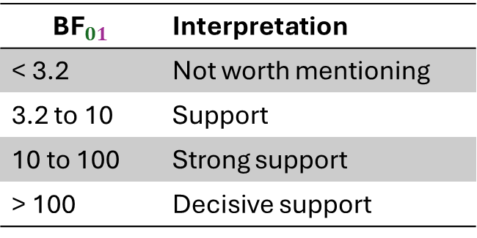
Savage-Dickey
$${\text{BF}}_{01}$$ | Interpretation
< 3.2 | Not worth mentioning
3.2 to 10 | Support
10 to 100 | Strong support
> 100 | Decisive support
Notes:
Bayes factor is sensitive to the prior.
It should not be interpreted alone.
It should be read together with the posterior plot, HDI, and ROPE decision.
This section should be shorter than the ROPE/HDI section.
Code reference
The code computes the density at zero using KDE and also uses az.plot_bf.

Slide 32
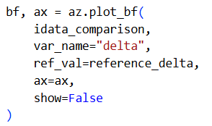
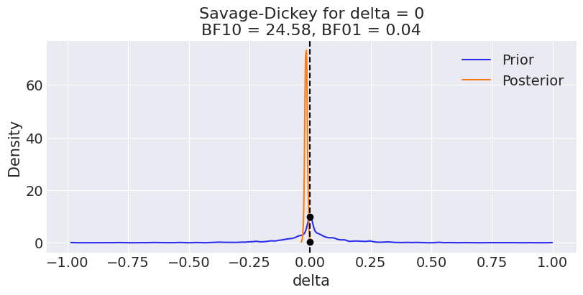
Savage-Dickey in our model
Notes:
Bayes factor is sensitive to the prior.
It should not be interpreted alone.
It should be read together with the posterior plot, HDI, and ROPE decision.
This section should be shorter than the ROPE/HDI section.
Code reference
The code computes the density at zero using KDE and also uses az.plot_bf.

Slide 33
Reporting
The observed Biotechnology startup rate was 0.014 in IND and 0.030 in CHN. The observed difference was -0.017.
Under the hierarchical Bayesian model, the posterior mean difference (IND - CHN) was -0.016, with a 94% HDI from -0.025 to -0.006.
The posterior probability that the difference is positive was 0.001.
The ROPE/HDI decision was: No clear decision.
Notes:
Savage-Dickey is a useful way to compute a Bayes factor for a point null, but it is sensitive to the prior and to numerical density estimation.
Therefore, it should be interpreted together with the posterior, HDI, and ROPE.

Slide 34
Significance, Power and Errors

Slide 35
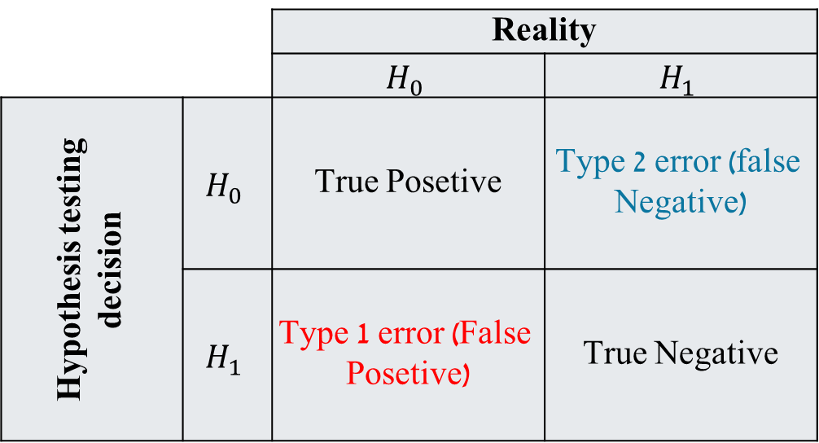
Error Types
Type I error - rejecting the null hypothesis when the null hypothesis is true.
Type II error - failing to reject a false null model
Reality
$$H_{1}$$ | $$H_{0}$$
Type 2 error (false Negative) | True Posetive | $$H_{0}$$ | Hypothesis testing decision
True Negative | Type 1 error (False Posetive) | $$H_{1}$$

Slide 36
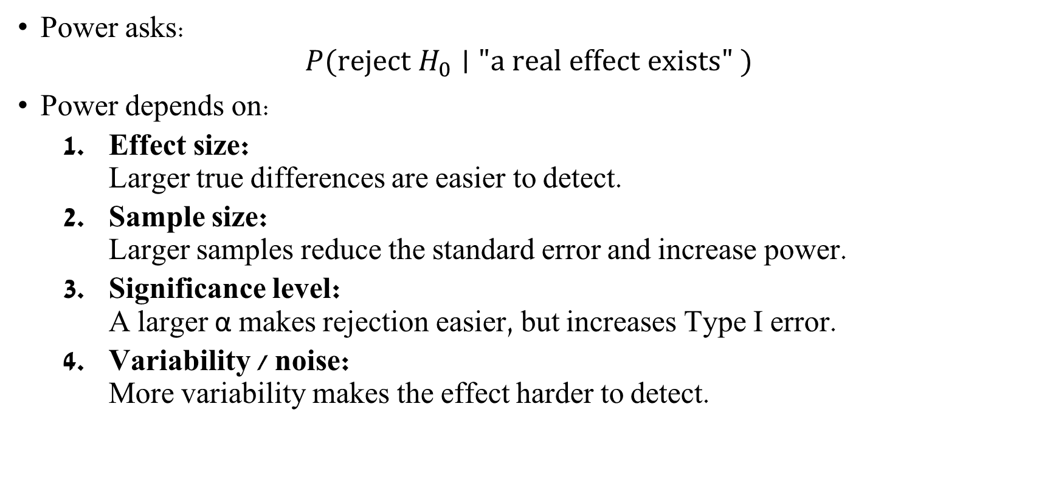
Power analysis
Power asks:
$$P(\text{reject} H_{0}∣"a real effect exists" )$$
Power depends on:
Effect size: Larger true differences are easier to detect.
Sample size: Larger samples reduce the standard error and increase power.
Significance level: A larger α makes rejection easier, but increases Type I error.
Variability / noise: More variability makes the effect harder to detect.
Notes:
במילים: ההסתברות לא לזהות אפקט למרות שבאמת יש אפקט. מתכתב עם טעות מסוג 2.

Slide 37
Pre-hoc vs post-hoc power
Pre-hoc power: used before collecting data to plan sample size.
Post-hoc power: calculated after seeing the data; often less useful and can be misleading.
Notes:
In the code, the observed effect is used as an example effect size for simulation.This is for teaching only. In a real study, pre-hoc power should ideally be based on a scientifically meaningful effect size, not only on the observed effect.
The power curve shows that:larger samples increase powersmall effects require larger samplesa non-significant result can happen because the test had low power

Slide 38
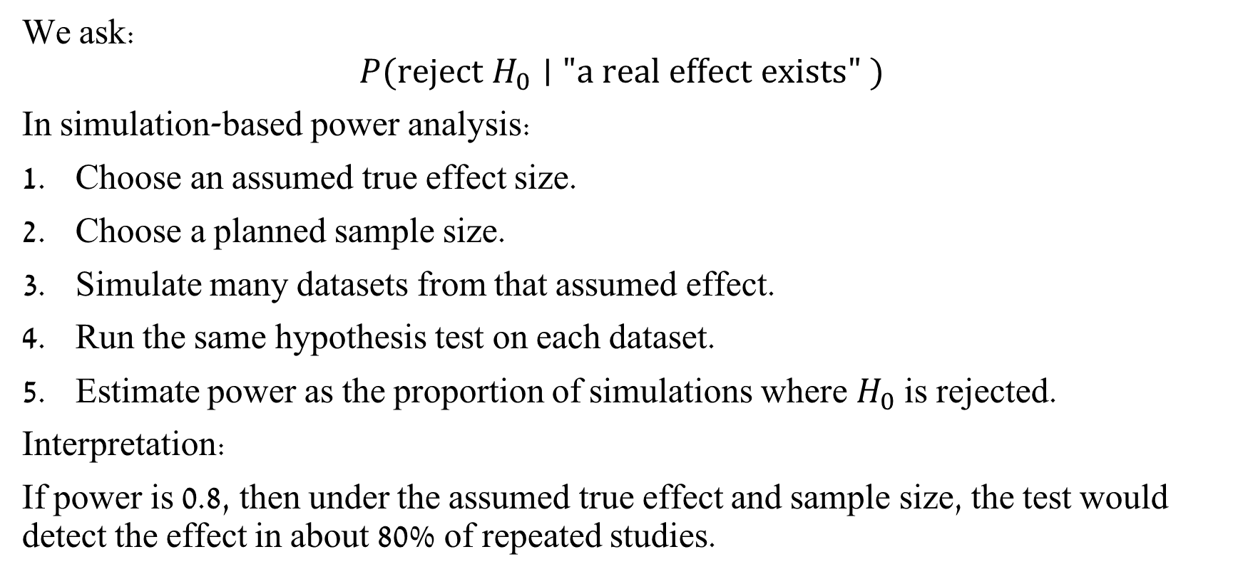
Pre-hoc Power
We ask:
$$P(\text{reject} H_{0}∣"a real effect exists" )$$
In simulation-based power analysis:
Choose an assumed true effect size.
Choose a planned sample size.
Simulate many datasets from that assumed effect.
Run the same hypothesis test on each dataset.
Estimate power as the proportion of simulations where $H_{0}$ is rejected.
Interpretation:
If power is 0.8, then under the assumed true effect and sample size, the test would detect the effect in about 80% of repeated studies.
Notes:
Using the simulation, we see that we need more than ~1,200 samples per group to get power > 0.8.
In the code, the observed effect is used as an example effect size for simulation. This is for teaching only. In a real study, pre-hoc power should ideally be based on a scientifically meaningful effect size, not only on the observed effect.
The power curve shows that:l arger samples increase power. small effects require larger samples. a non-significant result can happen because the test had low power

Slide 39
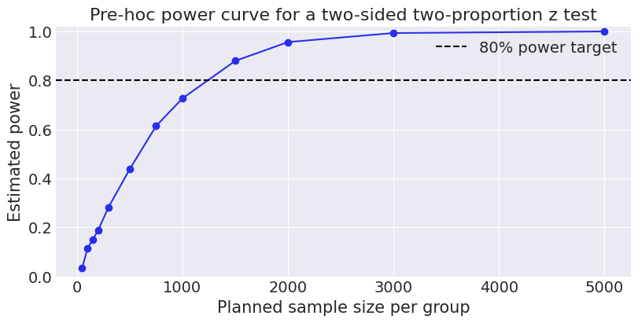
Pre-hoc Power
The simulated power curve shows that:
larger samples increase power.
small effects require larger samples.
a non-significant result can happen because the test had low power
Notes:
Using the simulation, we see that we need more than ~1,200 samples per group to get power > 0.8.
In the code, the observed effect is used as an example effect size for simulation. This is for teaching only. In a real study, pre-hoc power should ideally be based on a scientifically meaningful effect size, not only on the observed effect.
The power curve shows that:l arger samples increase power. small effects require larger samples. a non-significant result can happen because the test had low power

Slide 40
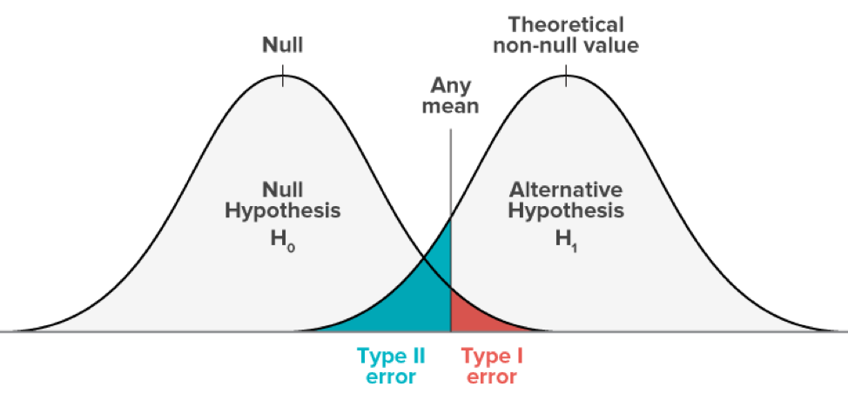



Post-hoc Power
Post-hoc power: calculated after seeing the data; often less useful and can be misleading.
$$power=1− β$$
$$1−β$$
1- 𝛼
$$β$$
𝛼
𝛼
Notes:
More powerful test - a test with a smaller probability of type II error

Slide 41
Frequentist Hypothesis Testing
Notes:
null hypothesis
test statistic
p-value
rejection / failure to reject
confidence interval

Slide 42
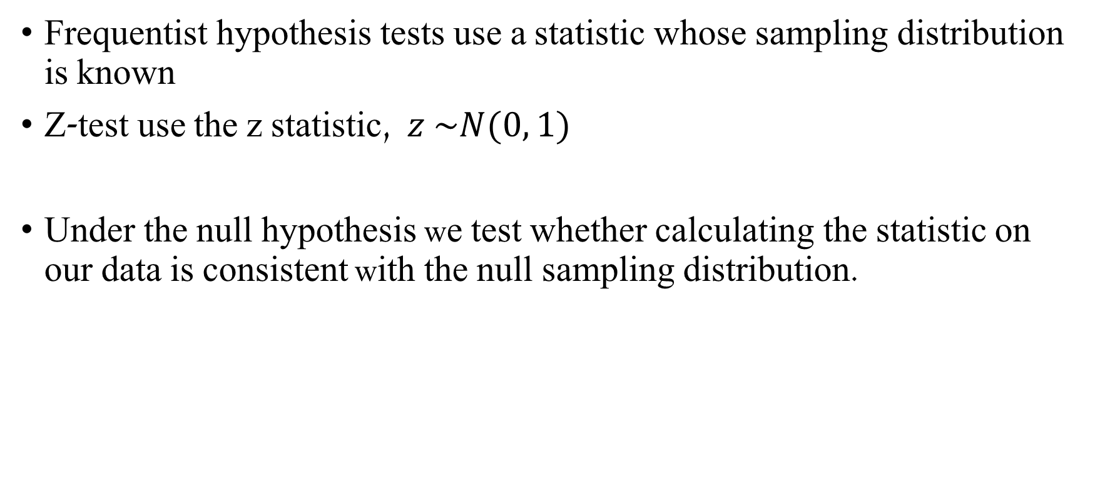
Frequentist Two-proportion Z-test
Frequentist hypothesis tests use a statistic whose sampling distribution is known
Z-test use the z statistic, $z \sim N(0, 1)$
Under the null hypothesis we test whether calculating the statistic on our data is consistent with the null sampling distribution.

Slide 43
Frequentist Two-proportion Z-test
Assumptions
Random sampling
Independent groups
Large sample size The test relies on a normal approximation. If the sample is too small, the approximation may be unreliable.
Known population variance
​If the assumptions are not met, use a different test or interpret the result cautiously.
Notes:
בדרך כלל משתמשים במבחן z כאשר:
יש לנו מדגם גדול מספיק.
התפלגות הדגימה של האומד בקירוב נורמלית.
סטיית התקן של התפלגות הדגימה ידועה או ניתנת להערכה טובה.
במבחני פרופורציות, משתמשים בקירוב נורמלי להתפלגות הבינומית.

Slide 44
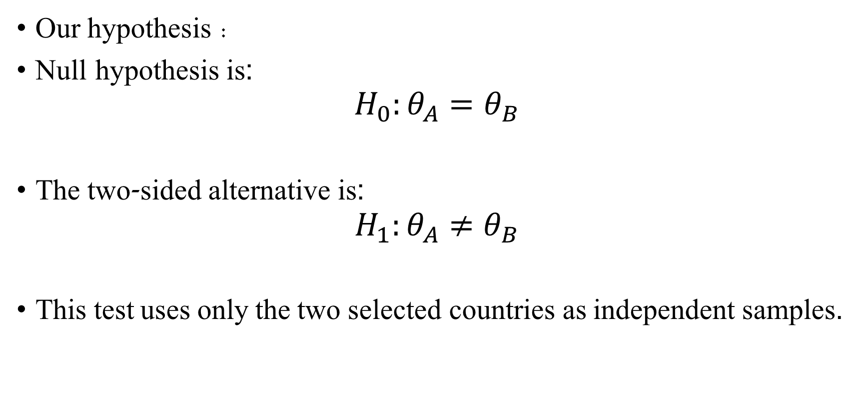
Frequentist Two-proportion z-Test
Our hypothesis :
Null hypothesis is:
$$H_{0}:θ_{A}=θ_{B}$$
The two-sided alternative is:
$$H_{1}:θ_{A}≠θ_{B}$$
This test uses only the two selected countries as independent samples.

Slide 45

Z Statistic
$$z=\frac{{\hat{θ}}_{A}−{\hat{θ}}_{B}}{\sqrt{{\hat{θ}}_{pooled}\left(1−{\hat{θ}}_{pooled}\right)\left(\frac{1}{n_{A}}+\frac{1}{n_{B}}\right)}}$$
Where:
$${\hat{θ}}_{pooled}=\frac{z_{A}+z_{B}}{n_{A}+n_{B}}$$
Notes:
“Pooled” means that under the null hypothesis, we combine the two groups and estimate one shared probability for both groups.
This shared probability is then used to calculate the standard error of the difference under H0 ​.

Slide 46
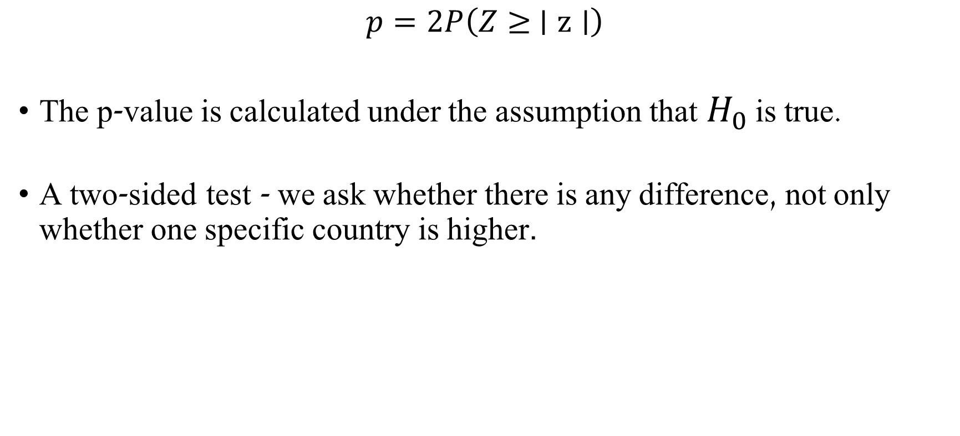
Two-sided p-Value
$$p=2P\left(Z≥ ∣z∣\right)$$
The p-value is calculated under the assumption that $H_{0}$ is true.
A two-sided test - we ask whether there is any difference, not only whether one specific country is higher.
Notes:
The p-value is not the probability that $H_{0}$is true!

Slide 47
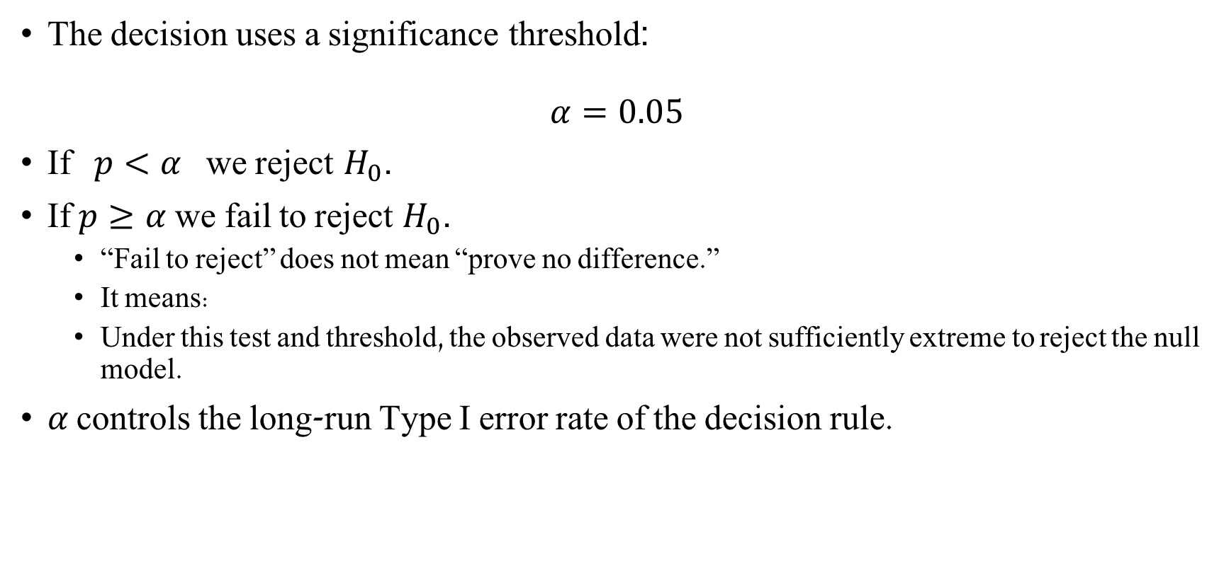
Significance
The decision uses a significance threshold:
$$α=0.05$$
If $p<α$we reject $H_{0}$.
If $p≥α$we fail to reject $H_{0}$.
“Fail to reject” does not mean “prove no difference.”
It means:
Under this test and threshold, the observed data were not sufficiently extreme to reject the null model.
𝛼 controls the long-run Type I error rate of the decision rule.
Notes:
Type I error - rejecting the null hypothesis when the null hypothesis is true.

Slide 48
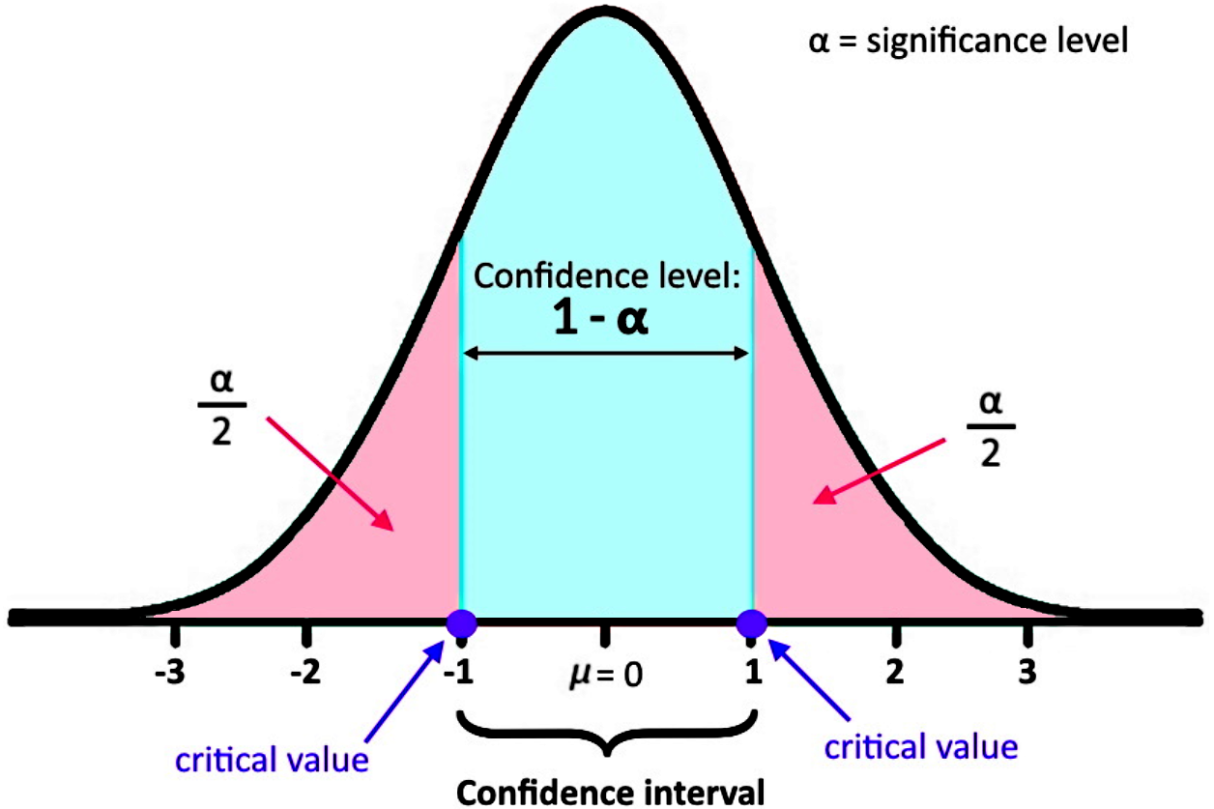

Reminder - Confidence Interval
The confidence interval is a frequentist uncertainty interval for the observed difference in proportions.
The z_critical value:
Lower tail : $P(Z>z_{crit}​)=0.025$
Upper tail: $P(Z≤z_{crit​})=0.975$
z_critical = stats.norm.ppf(1 – $α$/ 2)

Slide 49
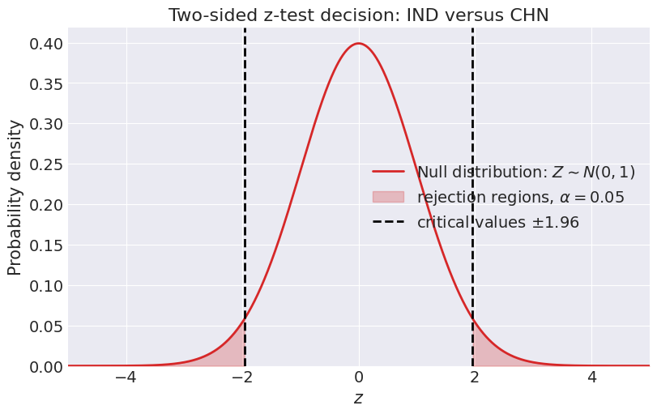
Frequentist Two-proportion z-Test
Notes:
If the observed z_statistic is in the “rejection zone” we will reject the null hypothesis

Slide 50


z-Test

Slide 51
z-Test
Calculating the thetas
Calculating the pooled theta and the std under the null model
Calculating the z statistic, p-value and z critical value
Calculating the confidence interval

Slide 52
z-Test

Slide 53
z-Test

Slide 54

z-Test

Slide 55

z-Test
z-test interpretation:
Observed z = -3.18
Critical values = ±1.96
Two-sided p-value = 0.001459
Decision: Reject H0 at alpha = 0.05.
Confidence interval interpretation:
Observed difference = -0.0167 95% CI = [-0.0270, -0.0064]
The CI does not include 0, consistent with rejecting H0.

Slide 56
Statistical reporting
The two-sided two-proportion z test gave z = -3.18 and p = 0.001459. Therefore, using alpha = 0.05, we reject h0.

Slide 57
What did each method give us?
Analysis type | Quantity | What it answers
Observed data | observed difference | What difference did we see in the data?
Bayesian hierarchical model | posterior mean of (Delta) | What is the model-based estimated difference?
Bayesian hierarchical model | 94% HDI | What posterior uncertainty remains?
Bayesian ROPE/HDI | ROPE decision | Is the effect practically different from zero under the Bayesian model?
Savage-Dickey | Bayes factor | Did the data increase or decrease evidence around the null value?
Frequentist z-test | z statistic and p-value | Are the observed data extreme under the null sampling model?
Frequentist CI | confidence interval | What is the frequentist uncertainty interval for the difference?
Power analysis | power curve | How likely is this test to detect an effect of a given size?

Slide 58

Summary table

